Slide 1
Practical Bayesian Optimization of Machine Learning Algorithms
Authors: Jasper Snoek, Hugo Larochelle, and Ryan Adams
Presenters: Kyle Conrad and Sarah Baker

Slide 2
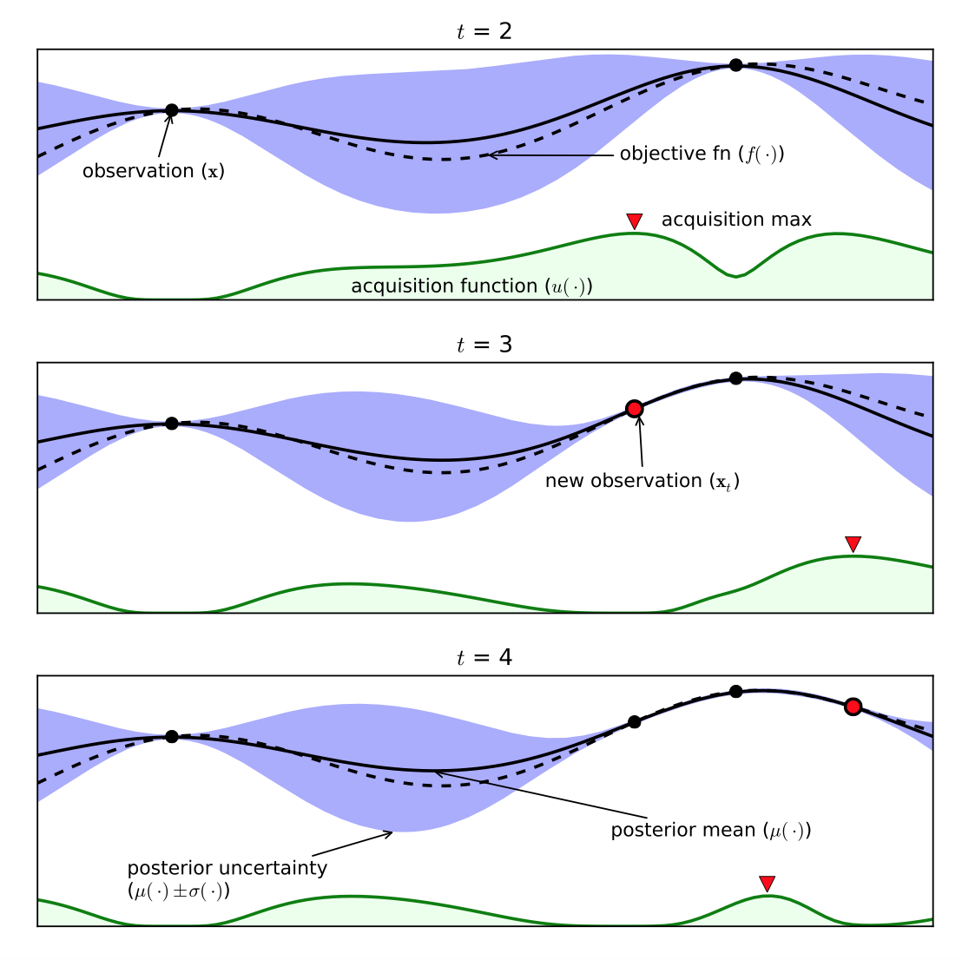
Using the Gaussian process in Bayesian optimization
Bayesian optimization uses a probabilistic model for f(x), using the minimum of this function on set X to decide where next to evaluate the function.
This process requires:
Gaussian process prior
f : X → R; where for any finite N {x_{n} ∈ X}^{N}_{n=1} R^{N} has a multivariate Gaussian distribution
An acquisition function
Figure 1. Brochu et al. (2010)
Acquisition functions are used to pick the next point that will be sampled
This function represents the balance between the value of the objective function and amount of uncertainty in the prediction

Slide 3

Bayesian optimization of machine learning algorithms
Machine learning algorithms find patterns in data and make predictions
In Bayesian optimization, hyperparameters are optimized using a Gaussian process
However, time to run machine learning algorithms is highly variable and Gaussian process is not always optimal
Assessing logistics of new method
Bayesian treatment for the entire Kernel
Provides algorithms for assessing cost of running experiment based on:
Time to run depending on units
Use of multiple cores
The most common method: the machine learning algorithm samples from a Gaussian process with hyperparameters generated by optimizing the expected improvement (EI)
Proposed method: instead of generating hyperparameters from optimization of EI, apply Bayesian treatment to whole kernel
0*QYxNNYh6W9jO1b_-.png

Slide 4
More on acquisition functions
The following can be used as acquisition functions:
Probability of Improvement
Expected Improvement
Upper Confidence Bound of the Gaussian Process
f(x) ~ Gaussian process prior with observations {x_{n}, y_{n}}^{N}_{n=1}
Where: y_{n} ~ N(f(x_{n}), v) and v = variance of noise
The prior and the data are used to find the posterior distribution, and the acquisition function is used to find our next point to evaluate using:
x_{next} = argmax_{x} a(x)
Where a(x) is the acquisition function, and depends on all previous observations and the hyperparameters of the Gaussian process

Slide 5
Practical Considerations - Covariance Function
Appropriate choice of covariance function and its associated hyperparameters is often ambiguous in practical problems.
Propose ARD Matern 5/2 kernel as a covariance function.
The hyperparameters governing the behavior of the Gaussian Process must also be optimized.
Propose a fully-Bayesian treatment of the hyperparameters by marginalizing over θ and compute the integrated acquisition function:
Notes:
Slide 1 - Practical Considerations - Covariance Function
(Prior to First Click): Choice of covariance function and its associated hyperparameters is often ambiguous in practical problems
- Will see in the empirical analysis that the choice of covariance function has a large impact on the rate of convergence and overall optimization
(After first click): Discuss why the ARD Matern 5/2 Kernel is proposed
- Often the default choice of kernel function is the Automatic Relevance Determination (ARD) Squared Exponential kernel.
- However, use of this kernel gives rise to sample functions which are unrealistically smooth for practical optimization problems.
- It results in sample functions which are unrealistically smooth for practical optimization problems
- The authors propose the use of the ARD Matern 5/2 Kernel
- Sample functions arising from this covariance function are twice differentiable (satisfy assumptions made by common machine learning methods - such as quasi-Newton methods)
- Sample functions are not required to be as smooth as those which arise from the squared exponential kernel
(After second click): Optimizing the hyperparameters of the Gaussian Process
- The typical manner of optimization is to find a point estimate of the hyperparameters of the Gaussian Process by optimizing the marginal likelihood of the Gaussian Process’s output set given the input points and hyperparameters.
- The typical manner does not effectively account for the uncertainty in the hyperparameters of the Gaussian Process
(After Third Click): Proposed method of optimization
- A fully-Bayesian treatment of the hyperparameters implies marginalizing over the hyperparameters and computing the integrated acquisition function
(After fourth click): SHOWING THE INTEGRATED ACQUISITION FUNCTION
- The integrated acquisition function is the posterior expectation of the acquisition function.
- The resultant function can be thought of as a generalization which accounts for uncertainty in the hyperparameters.
- The integrated acquisition function is a blending of the acquisition functions coming from samples of the posterior over the GP hyperparameters. Markov Chain Monte Carlo methods may be used to obtain an estimate of the integrated acquisition function.
- Computational costs of both optimization and Markov Chain Monte Carlo are O(N^3)

Slide 6
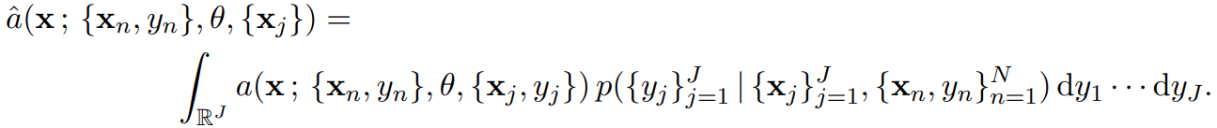
Practical Considerations - Costs and Parallelism
Ultimate goal of Bayesian Optimization is to find hyperparameter settings as quickly as possible, in terms of time not function evaluations
Propose optimizing with respect to the expected improvement per second
Parallelizing Bayesian Optimization Procedures
Propose taking advantage of multi-core parallelism by choosing new points based on the expected acquisition function under all possible outcomes of pending evaluations:
Notes:
Slide 2 - Practical Considerations - Costs and Parallelism
(Prior to the First click): Discuss why one would want to optimize in terms of some budgeted resources
- The most common thing one would want to optimize with respect to is speed of convergence in terms of real-world time
(First click): Propose optimization with respect to expected improvement per second
- Preferentially acquire points which are likely to be both good and evaluated quickly (at a low cost of the budgeted resource)
- Assuming the objective function and time to evaluate points are independent the expected improvement per second may be computed easily
(Second Click): Parallelizing Bayesian Optimization Procedures
- How might the parallel computing be incorporated into the proposed procedures of Bayesian Optimization
- Want to select new points to be evaluated while another set is currently being evaluated.
- Need to avoid using the same acquisition function again, otherwise would repeat other set of evaluations
(Third Click): Proposed method of Parallelization
- Use a Monte Carlo estimate of the acquisition function under all possible outcomes of pending function evaluations.
- If N evaluations have completed and J evaluations are pending then the next acquisition function would become: {CLICK MOUSE}
(Fourth Click): Show the parallelized integrated acquisition function
- This is the expected value of the acquisition function under all possible outcomes of the J pending evaluations
- Properties of the Gaussian distribution lead to an straightforward calculations which are efficient in practice

Slide 7
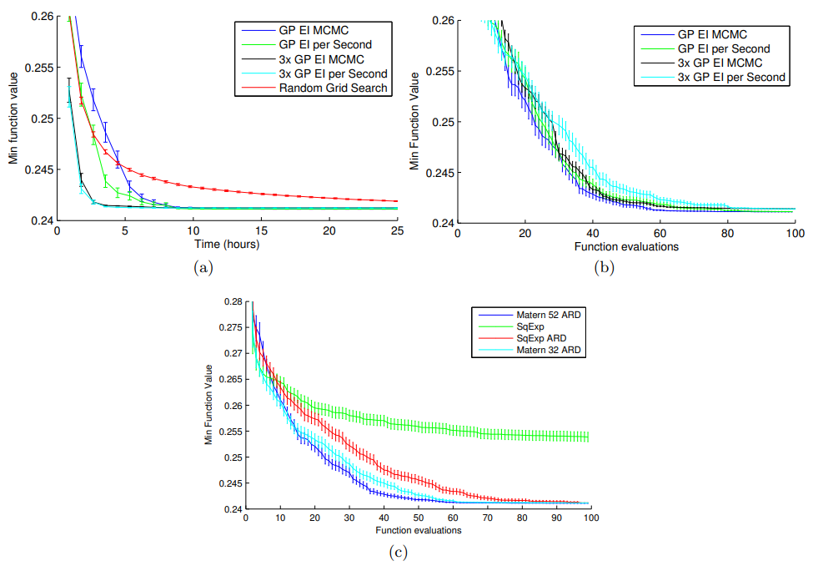
Empirical Analysis - M3E Models
Notes:
Slide 3: Empirical Analysis - Max-Margin Min-Entropy Models
- Consider the problem of using Max-Margin Min-Entropy (M3E) Models in the Binary classification of protein DNA sequences via motifs in DNA subsequences
- Optimization was conducted over a grid of 1400 possible combinations of 3 models of parameters with each evaluated over 5 random 50-50 training and test splits.
- Parameters of structured SVMs are typically set via Random Grid Search which is computationally expensive.
- Introduce the graphics shown and describe their meanings
- (a) Shows that all the proposed algorithms beat the status quo
- (a and b) GP EI MCMC achieves minimum in fewest number of evaluations but is beaten by both the GP EI per Second and the parallelized tasks in terms of time taken in hours
- (a) Parallelized optimization achieves minimum in the least amount of time
- (c) See that choice of covariance function drastically influences the convergence rate. Additionally, the proposed kernel achieves it's minimum function value in less function evaluations than the other kernels

Slide 8
References
Snoek, Jasper, et al. Practical Bayesian Optimization of Machine Learning Algorithms,
https://arxiv.org/abs/1206.2944.
Brochu, Eric, et al. A Tutorial on Bayesian Optimization of Expensive Cost Functions, with Application to Active User Modeling and Hierarchical Reinforcement Learning, https://arxiv.org/pdf/1012.2599.pdf.

